Slide 1
MapleStoryM Auto Quest Assistant
Development
Developer: Johannes Liu

Slide 2
Introduction
MapleStory is one of the most popular video games for desktop around 2005. With the rise of mobile games, Neon also launched a mobile version of MapleStory called MapleStoryM. Different from MapleStory for the desktop, the MapleStory could have roles quickly grow by introducing the auto-quest system.
However, doing quests in MaplestoryM must have players stay on the phone and click the buttons to keep the quest going, which greatly consume players' time and make the players develop very habits.
In this project, we aim to develop an automatic quest framework for MapleStoryM to help plays get rid of the boring repeated quests.

Slide 3
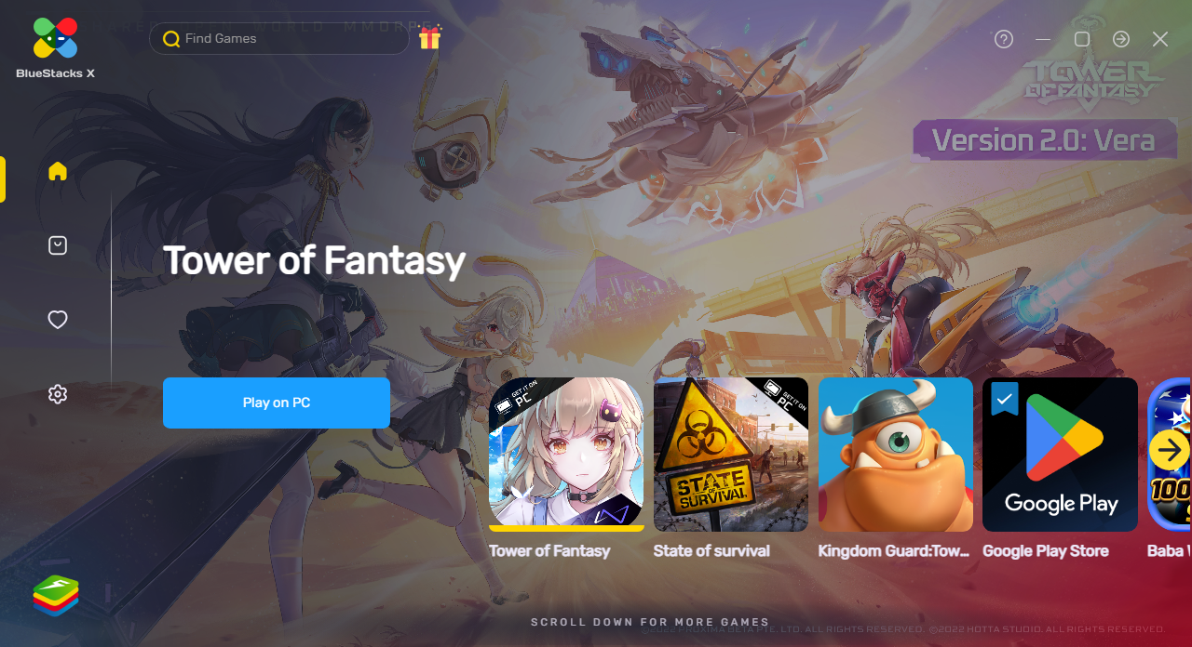
Simulation Requirements
Android Emulator Software
BlueStacks X
Code Development
Pycharm
Android SDK Platform
https://developer.android.com/studio/releases/platform-tools

Slide 4
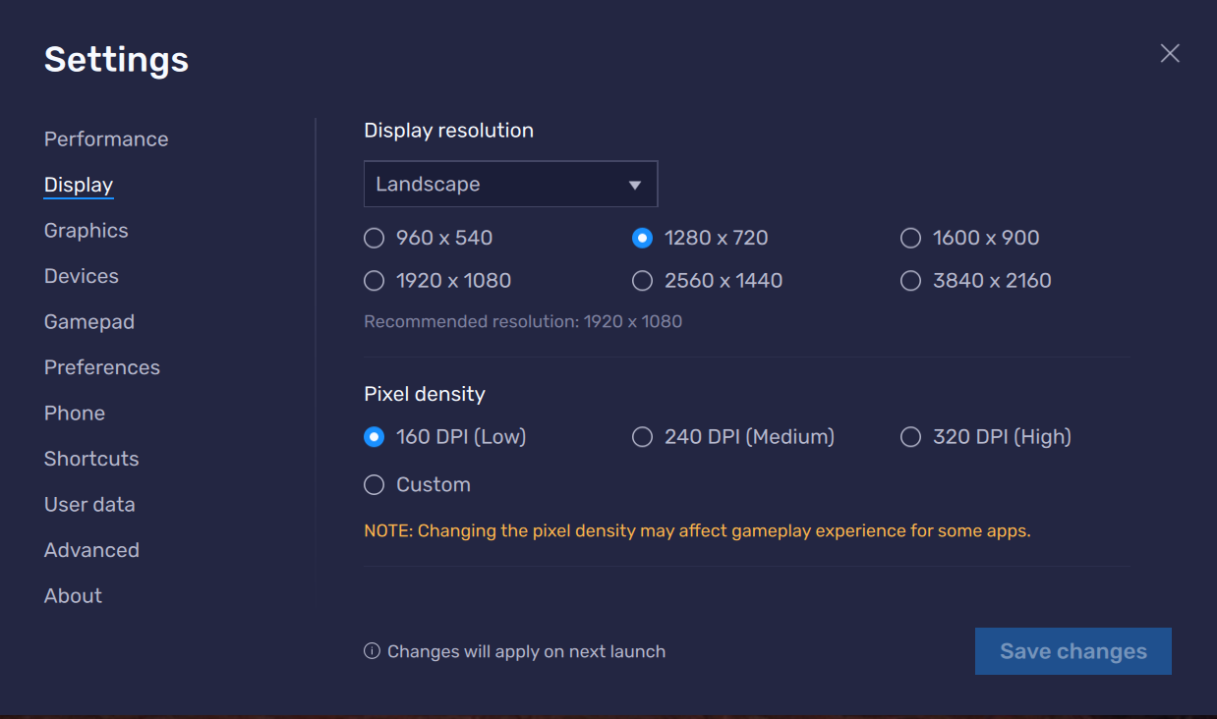
Simulation Setup
1. Change Settings of Display
Display - > 1280x720
Pixel Density ->160 DPI

Slide 5
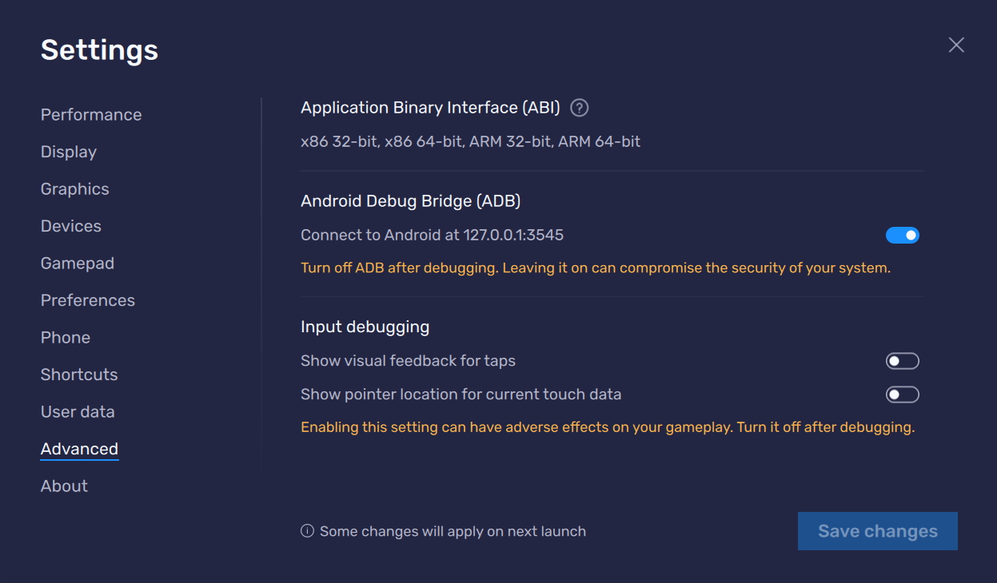
Simulation Setup
2. Enable ADB in Emulator
3. (Optional) Enable Show Pointer location for current touch data

Slide 6
Simulation Setup
3. Install Required Package
scikit-image
opencv-python
opencv-contrib-python
…
pip install –r requirements.txt

Slide 7
Code Development
1. Connect to BlueStacks Emulator
adb_port = 3545
print(os.popen('adb devices').read()) connect = os.popen("adb connect 127.0.0.1:" + str(adb_port)).read() print(connect)

Slide 8

Code Development
2. Load Potential Icons
accept_button_pic = cv2.imread("./raw_data/US/Buttons/Accept_Button.png") claim_button_pic = cv2.imread("./raw_data/US/Buttons/ClaimReward_Button.png") complete_button_pic = cv2.imread("./raw_data/US/Buttons/Complete_Button.png") confirm_button_pic = cv2.imread("./raw_data/US/Buttons/Confirm_Button.png") autoplay_button_pic = cv2.imread("./raw_data/US/Buttons/AutoPlay.png") go_manully_button_pic = cv2.imread("./raw_data/US/Buttons/GoManully.png") autoassign_button_pic = cv2.imread("./raw_data/US/Buttons/AutoAssign_Button.png") equip_button_pic = cv2.imread("./raw_data/US/Buttons/Equip-Button.png") Available2Start_ComplexButton_pic = cv2.imread("./raw_data/US/Buttons/Available2Start-ComplexButton.png") Complete_ComplexButton_pic = cv2.imread("./raw_data/US/Buttons/Complete-ComplexButton.png") CloseMail_Button_pic = cv2.imread("./raw_data/US/Buttons/CloseMail-Button.png") ReviveInTown_Button_pic = cv2.imread("./raw_data/US/Buttons/ReviveInTown-Button.png") AutoBattle_Status_pic = cv2.imread("./raw_data/US/Status/AutoBattle-Status.png") AutoQuest_Status_pic = cv2.imread("./raw_data/US/Status/AutoQuest-Status.png")

Slide 9
Code Development
2. Load Potential Icons
accept_button_pic = cv2.imread("./raw_data/US/Buttons/Accept_Button.png") claim_button_pic = cv2.imread("./raw_data/US/Buttons/ClaimReward_Button.png") complete_button_pic = cv2.imread("./raw_data/US/Buttons/Complete_Button.png") confirm_button_pic = cv2.imread("./raw_data/US/Buttons/Confirm_Button.png") autoplay_button_pic = cv2.imread("./raw_data/US/Buttons/AutoPlay.png") go_manully_button_pic = cv2.imread("./raw_data/US/Buttons/GoManully.png") autoassign_button_pic = cv2.imread("./raw_data/US/Buttons/AutoAssign_Button.png") equip_button_pic = cv2.imread("./raw_data/US/Buttons/Equip-Button.png") Available2Start_ComplexButton_pic = cv2.imread("./raw_data/US/Buttons/Available2Start-ComplexButton.png") Complete_ComplexButton_pic = cv2.imread("./raw_data/US/Buttons/Complete-ComplexButton.png") CloseMail_Button_pic = cv2.imread("./raw_data/US/Buttons/CloseMail-Button.png") ReviveInTown_Button_pic = cv2.imread("./raw_data/US/Buttons/ReviveInTown-Button.png") AutoBattle_Status_pic = cv2.imread("./raw_data/US/Status/AutoBattle-Status.png") AutoQuest_Status_pic = cv2.imread("./raw_data/US/Status/AutoQuest-Status.png")

Slide 10
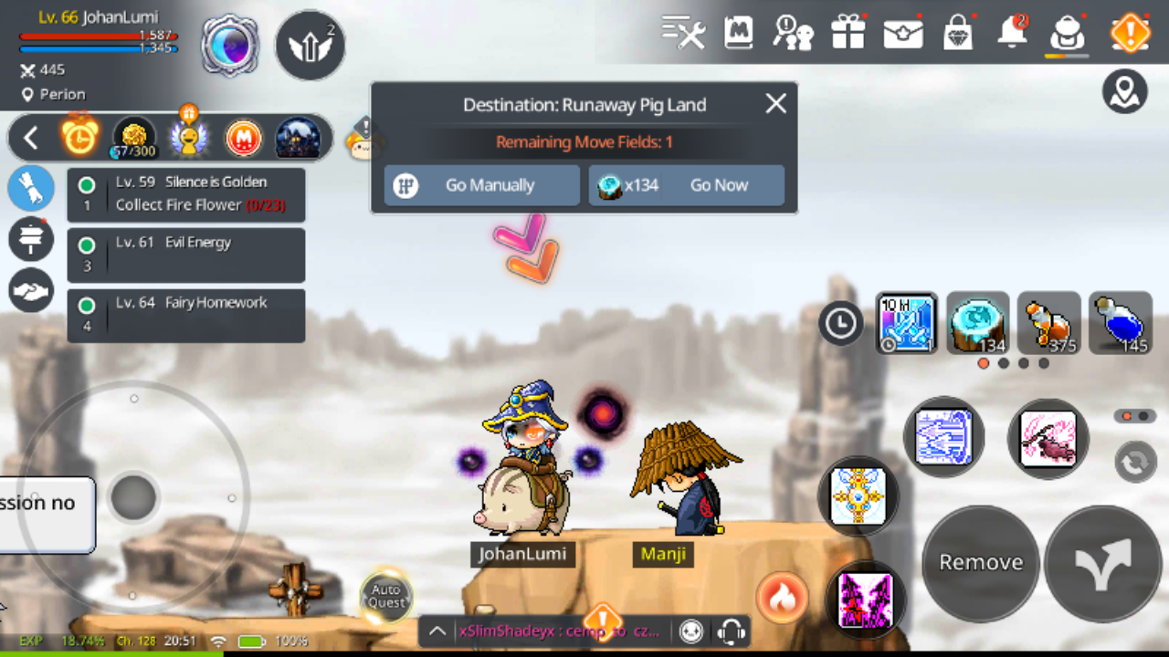
Code Development
2. Capture Screen
try: os.system('Adb shell screencap -p /sdcard/screenshot.png') os.system('adb pull /sdcard/screenshot.png ./screenshot.png') im = cv2.imread('./screenshot.png') os.system('adb shell rm /sdcard/screenshot.png') os.remove('./screenshot.png') except: print("Restart adb service") os.system("adb shell kill-server") os.system("adb shell start-server") os.popen("adb connect 127.0.0.1:" + str(adb_port)) continue

Slide 11
Code Development
3. Picture & Pixel comparison
if locateOnPicture(autoassign_button_pic, im, confidence = 0.8): print("Auto Assign") retVal = locateCenterOnPicture(autoassign_button_pic, im, confidence = 0.8) os.system("adb shell input tap " + str(retVal[0]) + " " + str(retVal[1])) time.sleep(1) elif locateOnPicture(equip_button_pic, im, confidence = 0.8): print("Auto Equip") retVal = locateCenterOnPicture(equip_button_pic, im, confidence = 0.8) os.system("adb shell input tap " + str(retVal[0]) + " " + str(retVal[1])) time.sleep(1) elif locateOnPicture(CloseMail_Button_pic, im, confidence=0.95): print("Close All Mail") retVal = locateCenterOnPicture(CloseMail_Button_pic, im, confidence=0.95) os.system("adb shell input tap " + str(retVal[0]) + " " + str(retVal[1])) time.sleep(1)
elif pixelMatchesColor(cv2.cvtColor(im,cv2.COLOR_BGR2RGB)[40, 110], (210, 195, 140), tolerance=20): print("Skip") os.system("adb shell input tap 284 402") time.sleep(2) else: os.system("adb shell input tap 1161 481") plt.imshow(im) print("Talking or Nothing to Do") time.sleep(0.1)

Slide 12
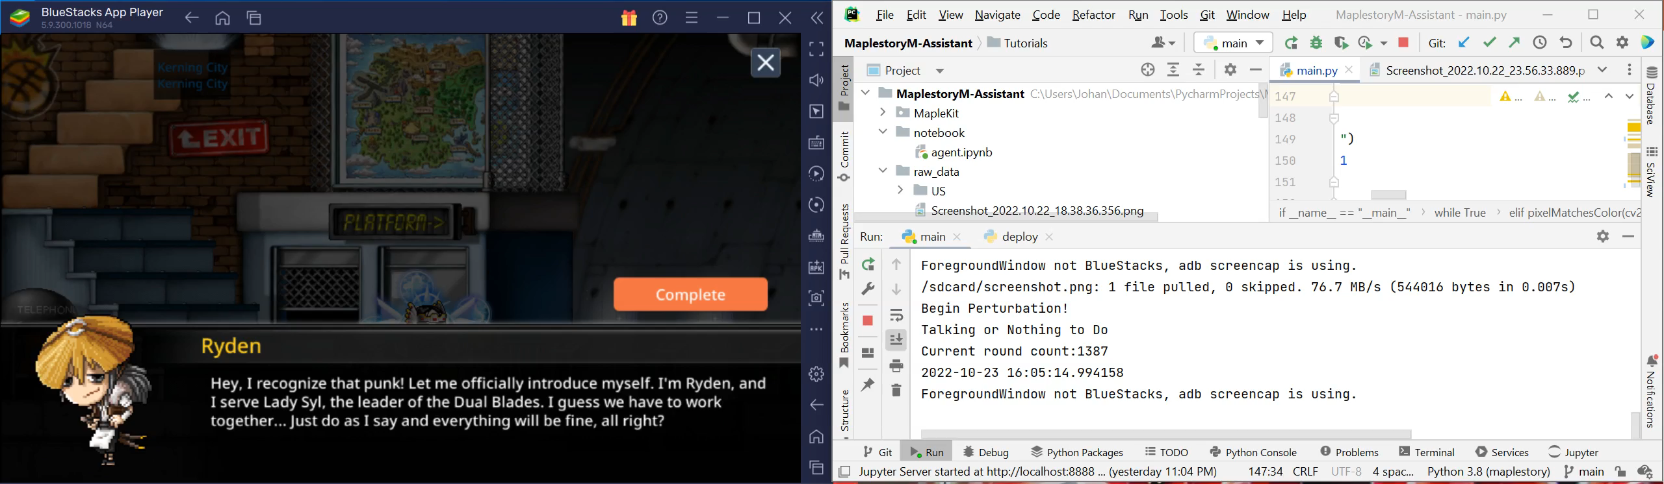
Simulation Demonstration

Slide 13
Limitation
Accuracy of Picture Recognition
Potential Solution: Neural Networks
Event Trigger Process
Automata
3. Resolution Compatible

Slide 14
Conclusion
In this Project, we develop an automatic quest framework for MaplestoryM, which can help roles interact with the environments automatically.
As far as we know, the existing solution provided by us can enable long time auto interactions for the roles.

Slide 15
Thanks for Your Attention
Code : https://github.com/johannesliu/Music-Genre-Classifcation
Personal Website: https://johannesliu.github.io

